Slide 1
Brain Tumor Classification Using Convolutional Neural Networks
CS 512 Final Project
Illinois Institute of Technology, Chicago
Department of Computer Science
Kinjal Kachi
A20449343
Omkar Pawar
A20448802

Slide 2
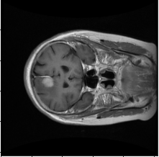
Problem Statement
In this project we try to create a neural network model which can be used to predict the class of the Magnetic Resonance Imaging (MRI) scan if there exists any of the tumor mentioned below
Meningioma
Glioma
Pituitary tumor.

Slide 3
Data Definition
The dataset that we will be using for our project is a brain tumor dataset posted by Jun Cheng on figshare.com. This data is organized in matlab data format (.mat file).
Dataset Consists of 3064 T1 Weighted contrast-enhanced images from 233 patients with three kinds of a brain tumor
Meningioma (708 slices)
Glioma (1426 slices)
Pituitary tumour (930 slices).
Region of Interests (3 types of tumors) are segmented and provided in .mat file format as a part of the database.

Slide 4
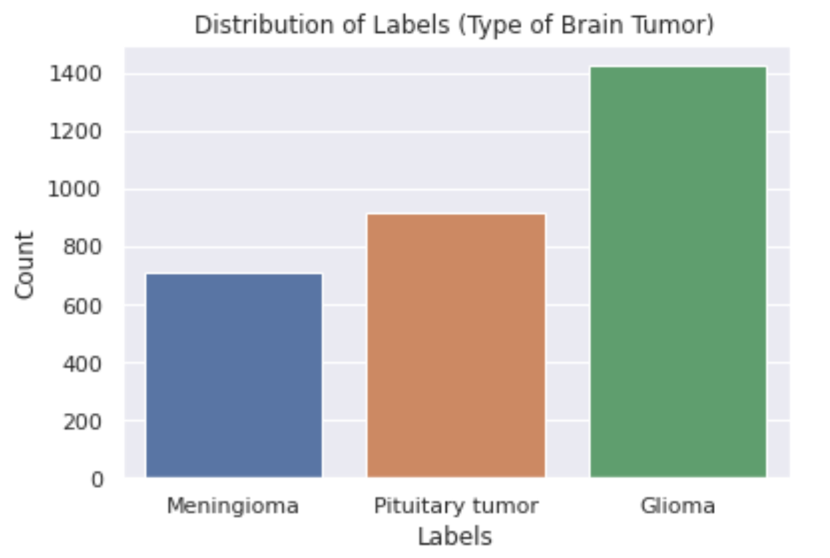
Data Preprocessing
Distribution of Class Labels
Transform Data to Python List
Seperate images and their respective labels
View distribution of labels
Use Stratified Sampling to split the data into training and validation sets
Save these sets to pickle file for further use.

Slide 5
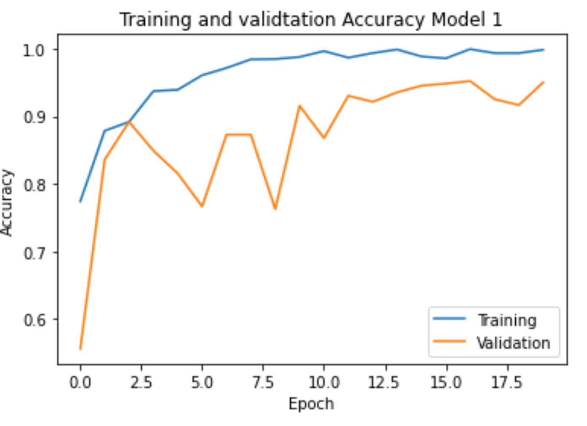
Data Modeling
Model 1
Defined a convolutional model that has the architecture as follows
2 Blocks of : Convolution -> Max Pooling -> Batch Normalization
Dropout Layer with a factor of 0.3
Flatten the convoluted image
Dense Layer -> Output Layer
Model compiling and training parameters
Activation Function = reLu, softmax
Loss Function = Categorical Crossentropy

Slide 6
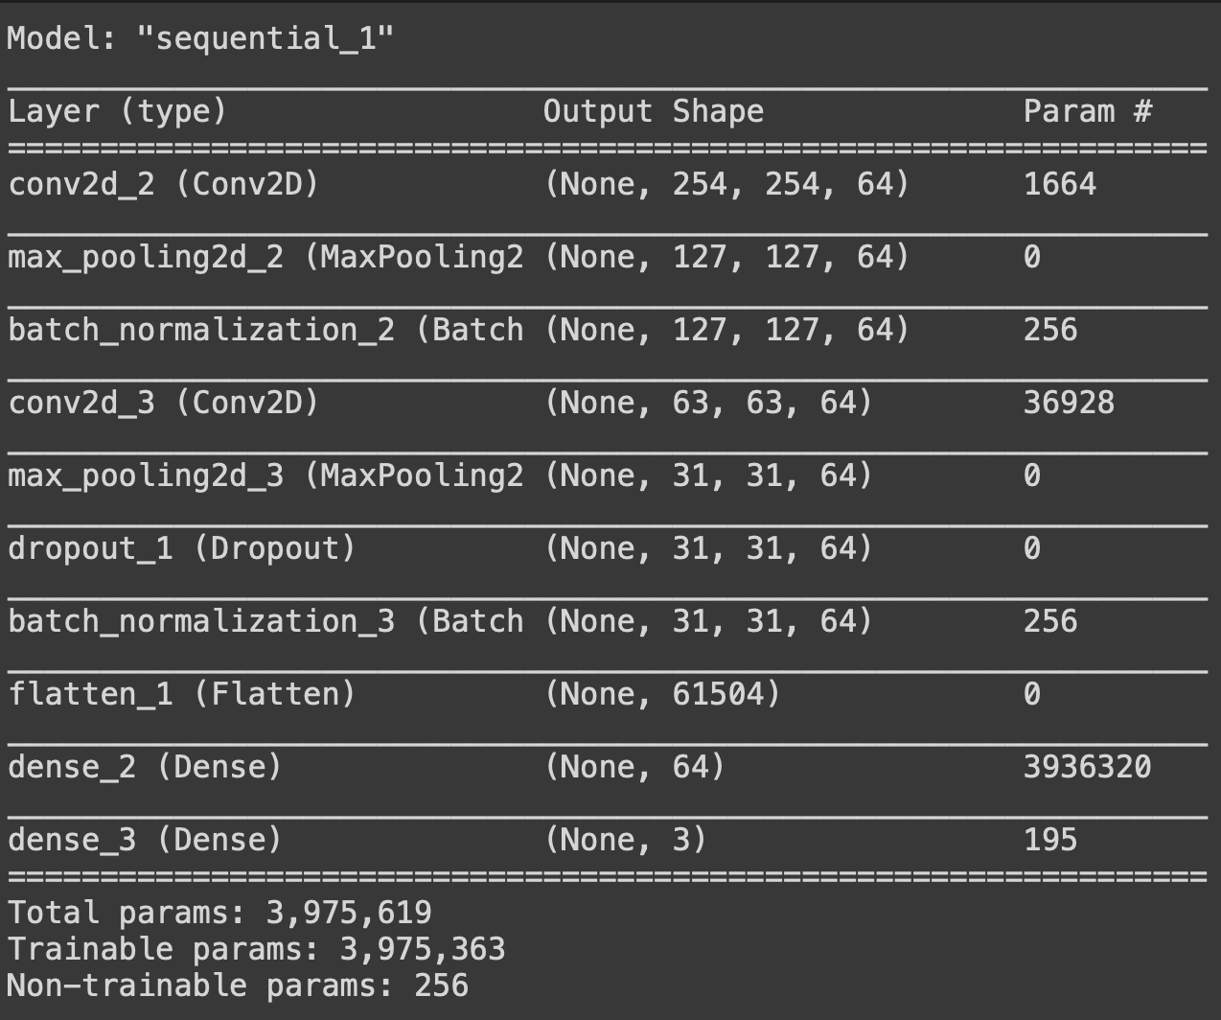

Slide 7
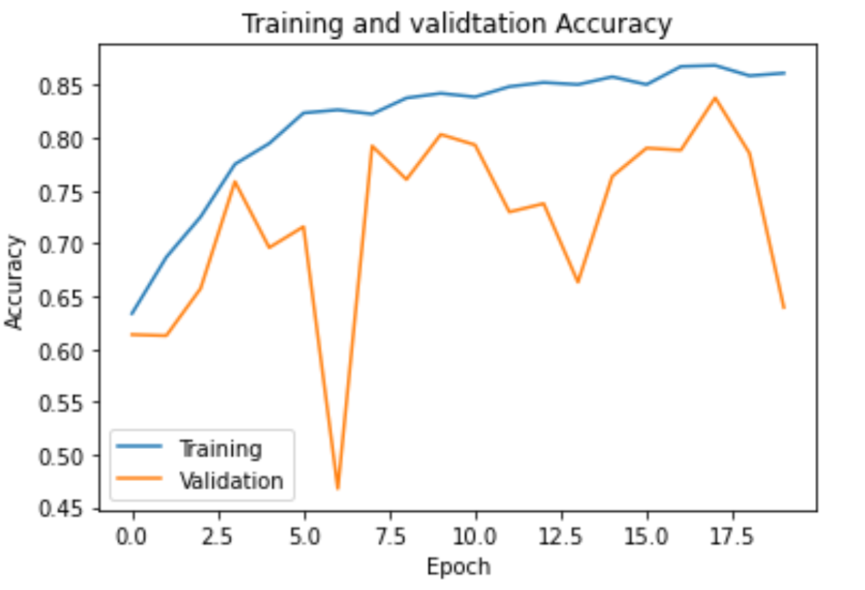
Data Modeling
Model 2: Using Data Augmentation
Same architecture as the previous model
Implemented Data Augmentation at runtime using ImageGenerator from Keras
Random flips(horizontal and vertical) and rotation of the image (by a factor of 90)
Does not perform well.

Slide 8
Transfer Learning
ResNet 50
Use the weights of already trained models and just change the input and output layers to make it work for our problem.
ResNet 50 is a deep convolutional neural network used for image classification
We freeze some layers so that the weights are not updates which reduces training time.

Slide 9
Results
Metric | Model 1 | With Data Augmentation | ResNet 50
Training Accuracy | 0.995 | 0.8688 | 0.9549
Training Loss | 0.0048 | 0.4140 | 0.4828
Validation Accuracy | 0.9523 | 0.8381 | 0.8689
Validation Loss | 0.1754 | 0.4877 | 1.1077
No. of Epochs | 20 | 20 | 10

Slide 10
Thank You

